Slide 1
User Story Mapping
From the car park through the hike
User
Selection of the hiking trail
Hiking tour part one: Start
Hiking tour part two: Lunch break
Hiking tour part three: End
Receive the info push from the Beacon
Start hiking the route from the car park
Receive location based information (e.g. restaurant recommendation, special offers)
Share the experience via social media after the hike
Set your personal preferences. Length, view points and break point for lunch.
Guided tour through the trail
MVP
Receive location based information (e.g. best view, environment)
Have a break
Register in the trail for additional rescue service
Receive location based environmental information (e.g. landslide with alternative route)
Browse to the recommended hiking trail
Trail information with weather conditions
Take and post pictures through the hiking experience
Give a extended feedback
Release 1
Rate the viewpoints
Rate the hiking trail (standard 5 star rating system)
Personal preference: Fitness program
Info push: special offers from mountain huts
If needed adjust the trail to the personal conditions
Release 2
Rate the lunch place
Random trail generator
Info push: warnings if the weather conditions change

Slide 2
Defining the WANDERLUST - MVP
Basic artefacts and functions of the MVP
Selection of the hiking trail
First touchpoint, welcome to WANDERLUST: Receive the info push from the Beacon
Your route your choices, full customer centricity: Set your personal preferences. Length, view points and break point for lunch.
Safety first: Register in the trail for additional rescue service
Route recommendation: Browse to the recommended hiking trail
Hiking tour part one: Start
Proactive guided route: Guided tour through the trail
The route talks to you - embedded feeling: Receive location based information (e.g. best view, environment)
Hiking tour part two: Lunch break
Location based information: Receive information about e.g. restaurant and special offers
Event based information: Receive environmental information (e.g. landslide warning)
Hiking tour part three: End
Social component: Share the experience via social media after the hike

Slide 3

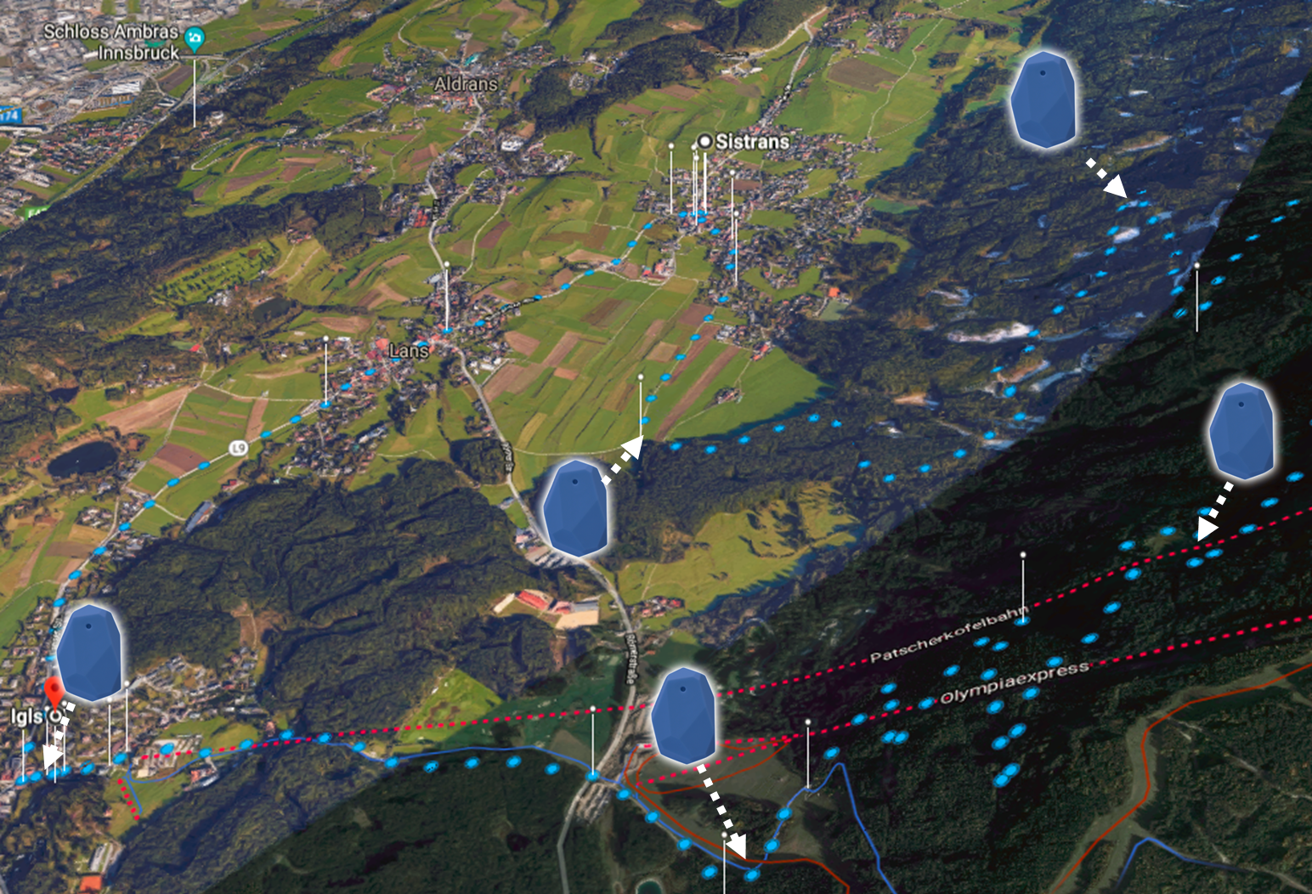

MVP - Route
Hiking as a Service
Share the experience via social media after the hike
info push
(URL)
Receive the info push from the Beacon
Set your personal preferences. Length, view points and break point for lunch.
Register in the trail for additional rescue service
Hiking tour part three: End
Smartphone
Cloud
Browse to the recommended hiking trail
Hiking tour part two: Lunch break
Selection of the hiking trail
Receive location based information (e.g. restaurant recommendation, special offers)
Start hiking the route from the car park
Have a break
Hiking tour part one: Start
Guided tour through the trail
Receive location based environmental information (e.g. landslide with alternative route)
Receive location based information (e.g. best view, environment)
Beacon
Each beacon is represented by an URL

